Slide 1
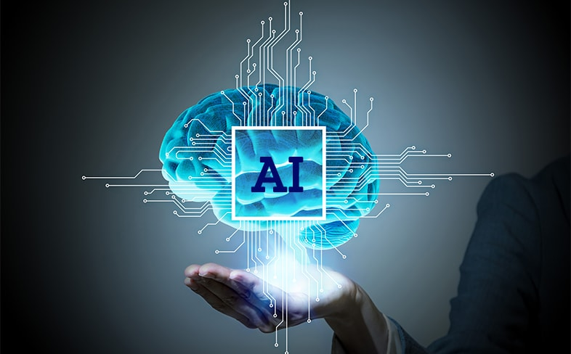

Slide 2
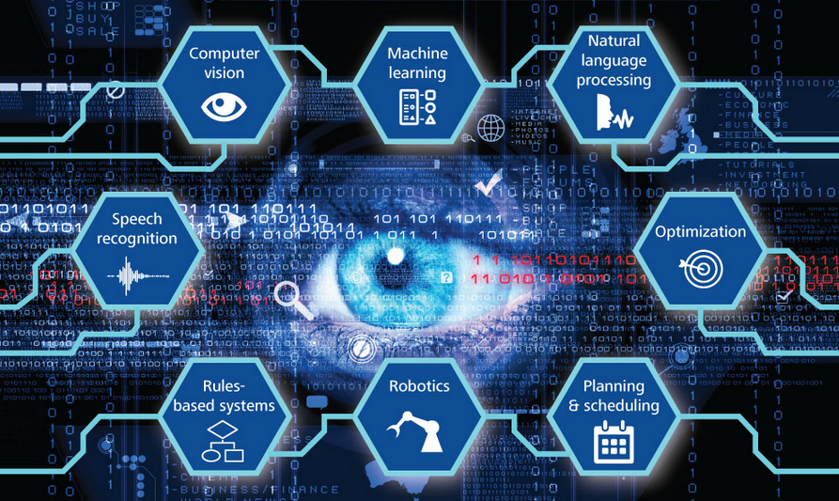
AI - Domains

Slide 3
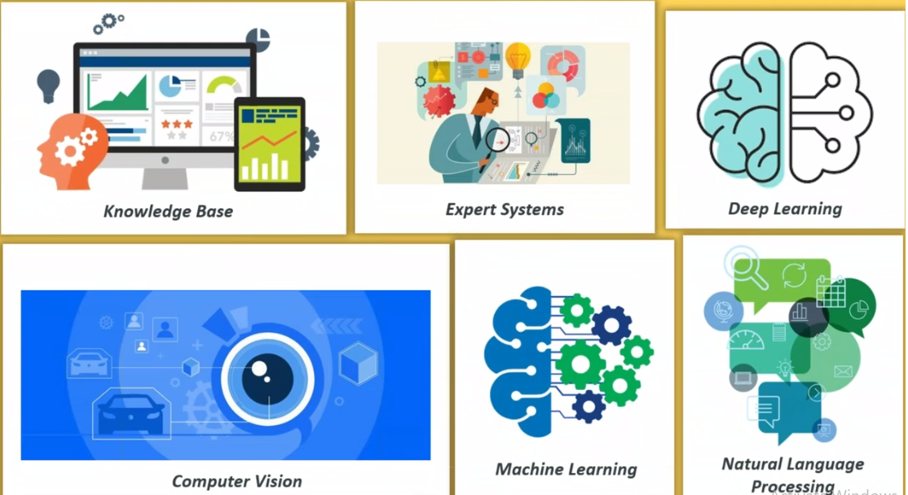
AI - Domains

Slide 4
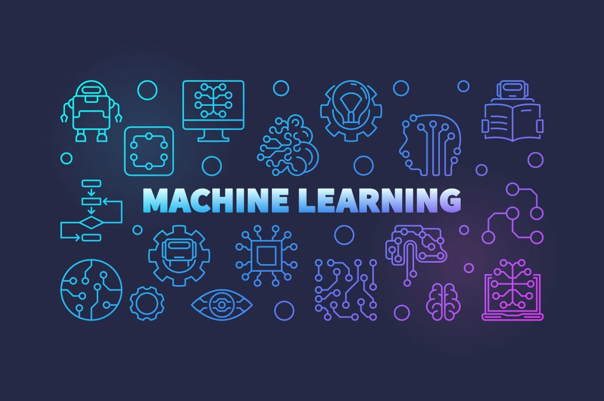

Slide 5


Slide 6
1.
History of AI
John McCarthy - 1956
Science and Engineering of making Intelligent machines

Slide 7
2.5 quintillion bytes of data are created every single day

Slide 8
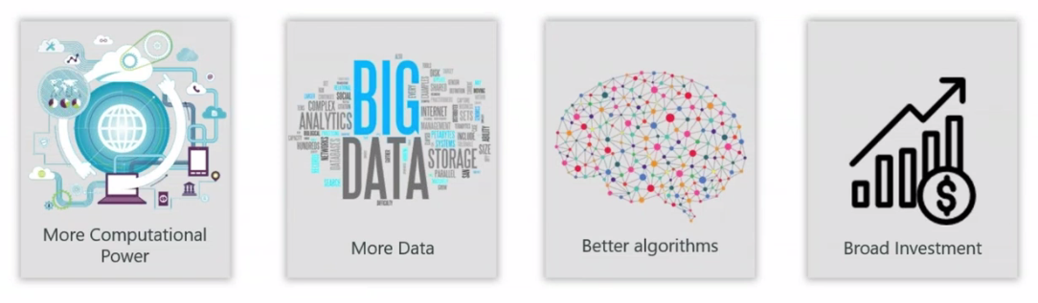
Why AI is famous now?
2.5 quintillion bytes(also called ExaBytes) of data is generated everyday

Slide 9
2.
Applications of AI
9

Slide 10


Recommendation System
( Logic behind this is AI)

Slide 11


A Supercomputer used in Health Care to cure rare Lukemia
https://www.asianscientist.com/2016/08/topnews/ibm-watson-rare-leukemia-university-tokyo-artificial-intelligence/

Slide 12

Amazon Recommendation System

Slide 13
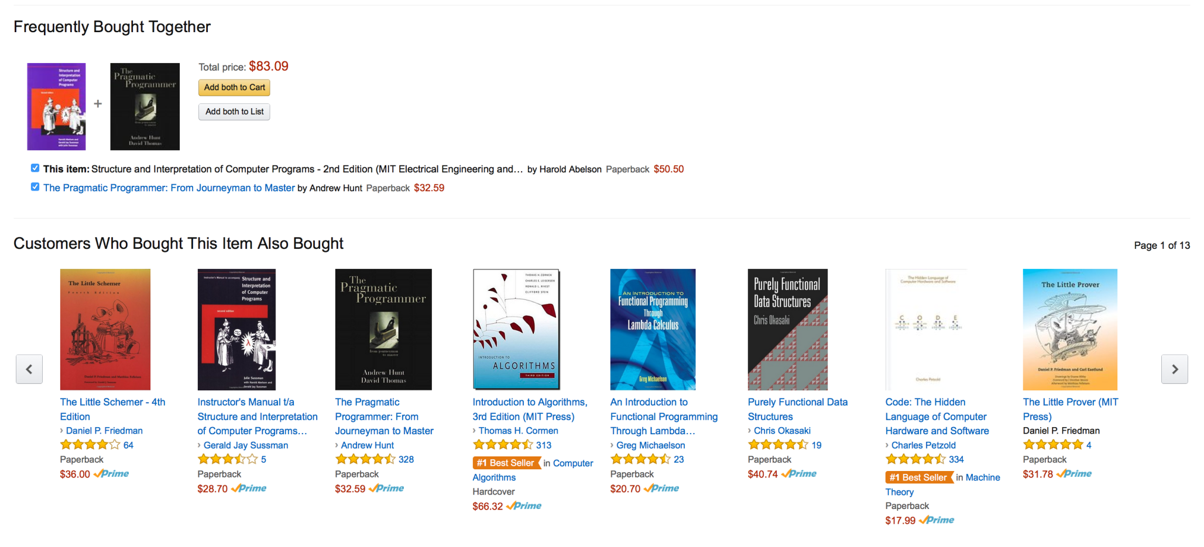

Slide 14

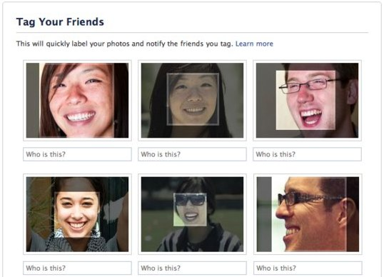
Facebook
Auto Tagging feature in FB

Slide 15
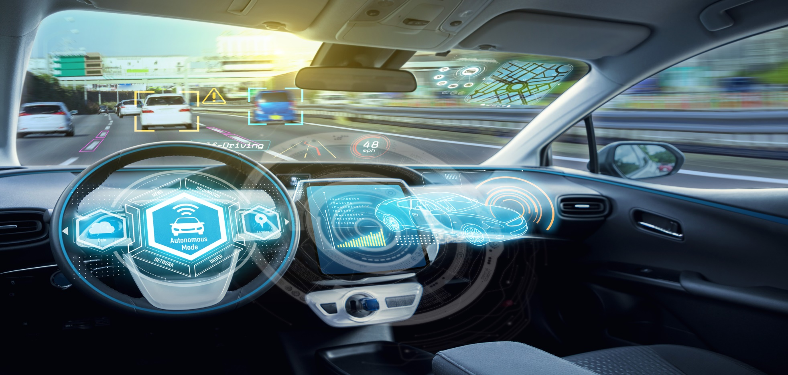
Self Driving Cars
Uses Deep Learning

Slide 16
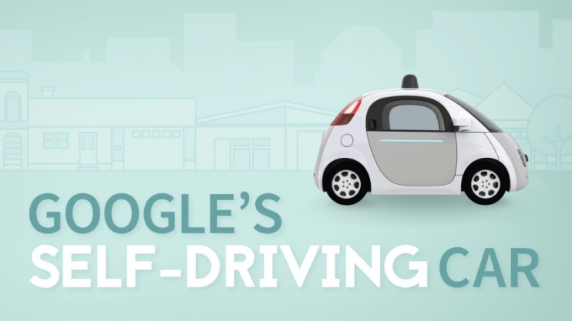



Slide 17
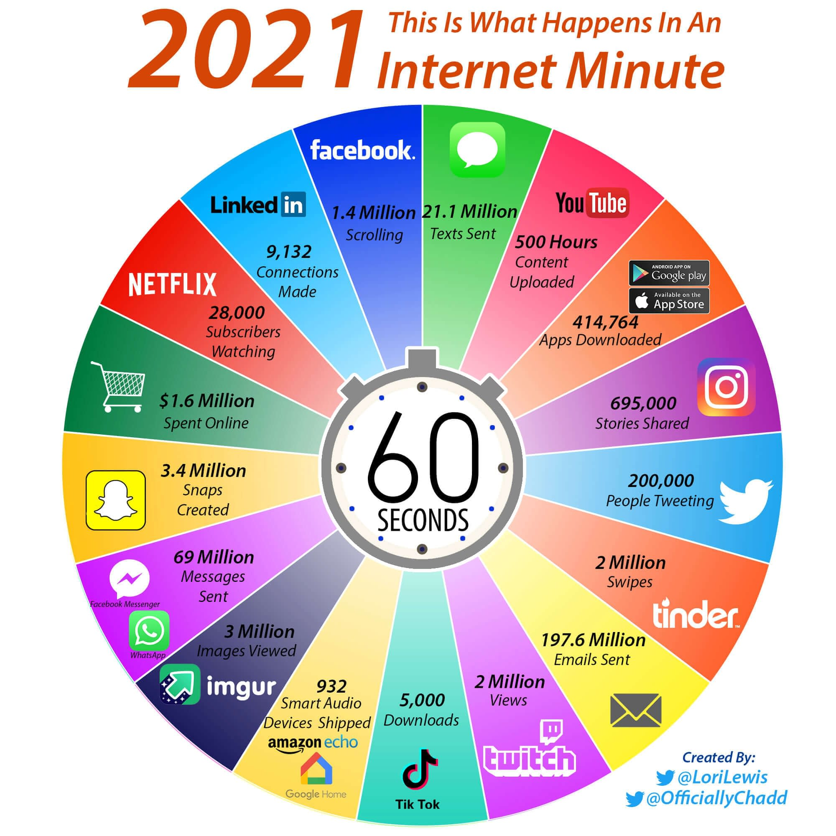

Slide 18

Languages for AI
Python
R Language
Java
Lisp

Slide 19
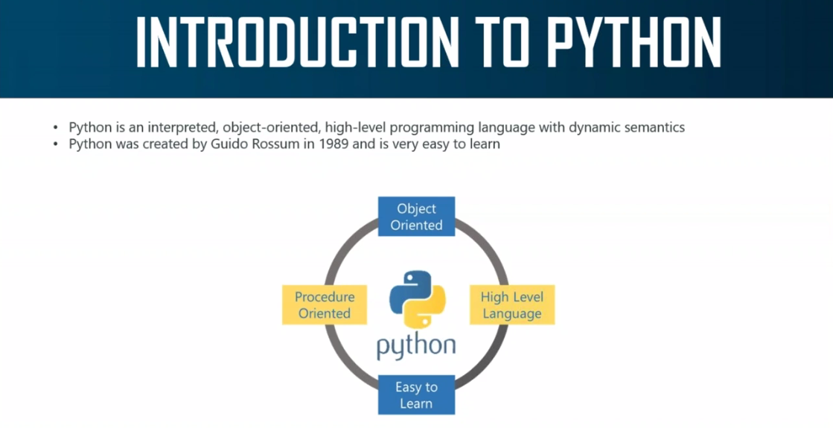
Version 3.9

Slide 20
Features of Python
Simple and Easy to understand
Free and Open Source
High- Level Language
Portable and Extensible
Supports multi-paradigm

Slide 21
Softwares
Python IDLE - offline
PyCharm - offline
Jupyter Notebook - Online/Offline
Google Colaboratory - Online
Kaggle Notebook - Online

Slide 22
Libraries
Numpy – Numerical Python
Matplotlib - Visualisation
Pandas – create dataframe,Series
Scikit-learn / Sklearn - Algorithms
opencv-python – Images/Videos

Slide 23
Python Core
Hello World
Normal Calculator
Data types – Int, Float, Char, Boolean
Variables
Functions
For loop
While loop
Break statement
If and else statements

Slide 24
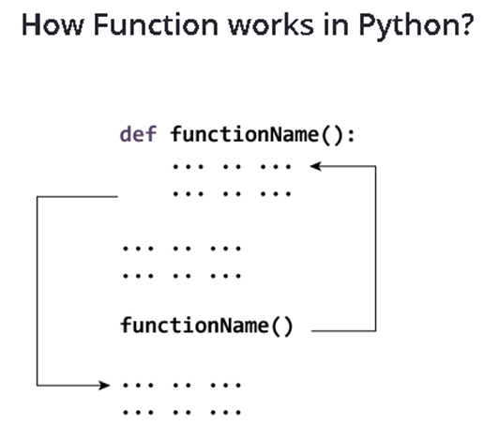
Functions

Slide 25
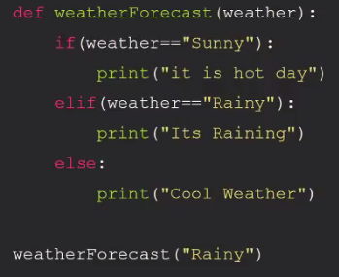

Slide 26
Sequences in Python
Lists
Tuples
Dictionary

Slide 27
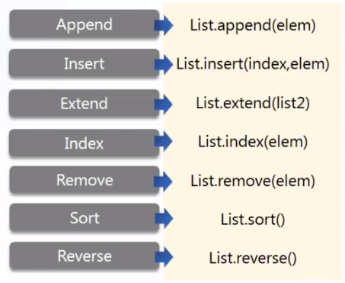
Lists
Fruits=[‘Mango’,’Apple’,’Orange’]

Slide 28
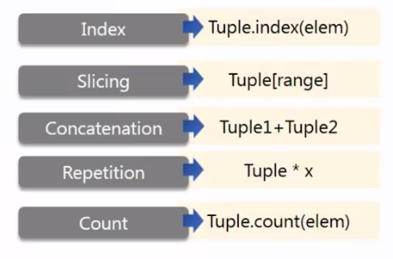
Tuples
NOTE: Tuple is immutable and is written in paranthesis
Try Tuple_name.__len__()

Slide 29
Why Tuples when we have lists?
Iterating through tuples is easier and faster
Tuples are immutable and is secure

Slide 30
Dictionaries

Slide 31
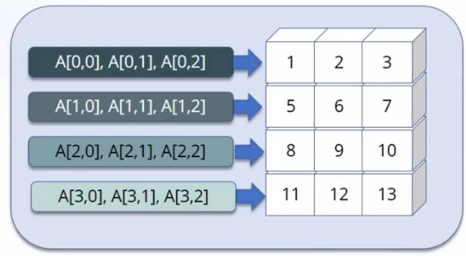
Numpy
Library for scientific computing
Difference between List and Numpy

Slide 32
Numpy Functions
np.array()
np.ones()
np.zeros()
np.arange(10)
np.linspace(1,3,5)
np.sum()
np.max()
np.min()
np.mean()
a.size
a.ndim
a.itemsize
a.dtype
a.shape
a.size

Slide 33
matplotlib.pyplot
Plotting library used for 2D graphics
Line plot
Scatter plot
Bar Graph
Pie Plot

Slide 34
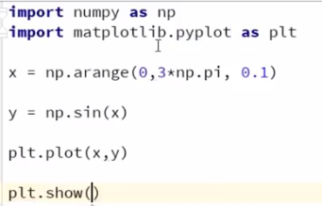
Matplotlib

Slide 35
Pandas
Import pandas as pd
df = pd.read_csv(‘path.csv’)

Slide 36
AI - Domains

Slide 37
AI - Domains

Slide 40
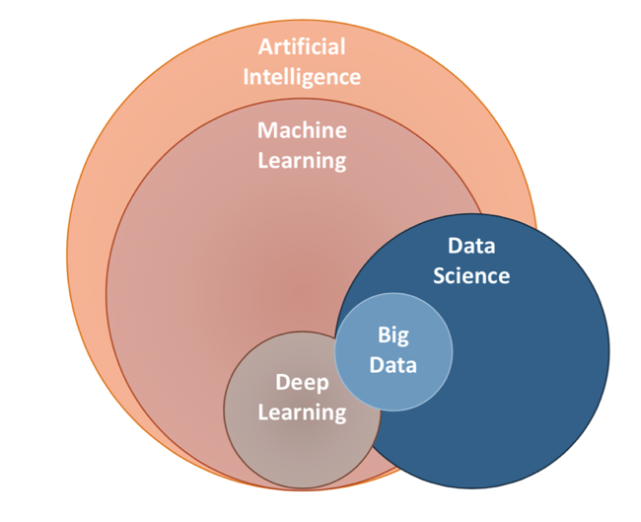
AI vs ML vs DL vs DS

Slide 41
Is Machine Learning same as Artificial Learning?
ML is used in AI
ML is way in which we feed in lot of data to a machine so that it makes its own decision

Slide 42
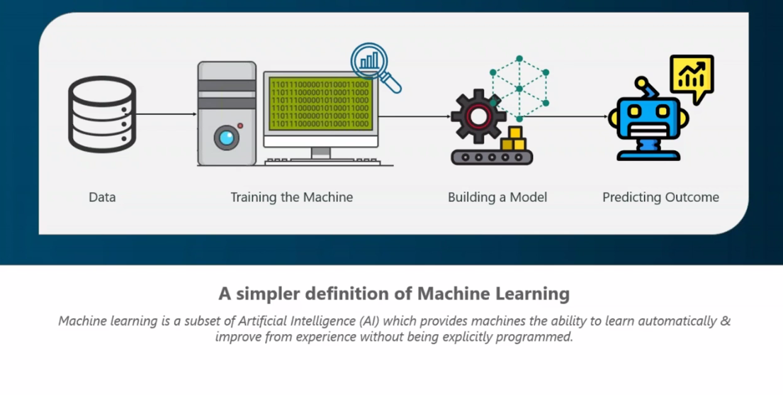
Data can be either : 1. Numbers
2. Text
3. Image
4. Videos
5. Audios

Slide 43

Terminologies
Algorithm - - Sets of procedures used to create a model from data
Model – A trained machine
Predictor Variable – Variable containing the Predicted output
Training data – Data given to machine
Testing data – Data used by machine to predict
Features – Inputs Values of Data
Labels/Targets – Output Values of Data

Slide 44
Features of ML
Detects the pattern from huge dataset
Finds hidden insights using Algorithms without being explicitly programmed
Automates the analytical model

Slide 45
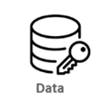




How it works?
Traditional
Programming
Machine Learning
Programming
def sum(a,b):
print(a+b)
sum(2,4)
>>>6
Program
Data
Learns from data
Finds insights
Train and grow
Output

Slide 46
Machine
Learning
Supervised Learning
Regression
Classification
Unsupervised
Learning
Clustering

Slide 47
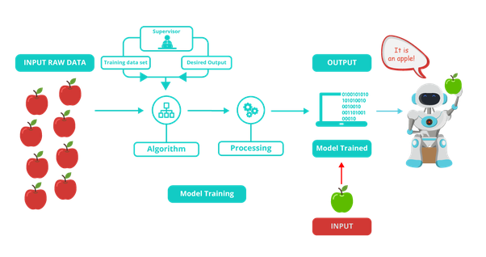
Supervised Learning
The data is well labeled

Slide 48
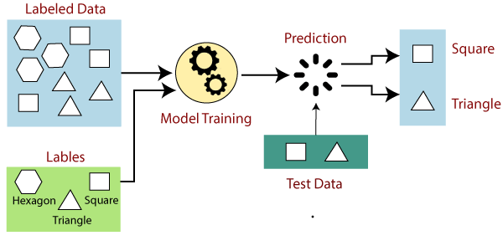
Supervised Learning
The data is well labeled
Classification
Regression

Slide 49
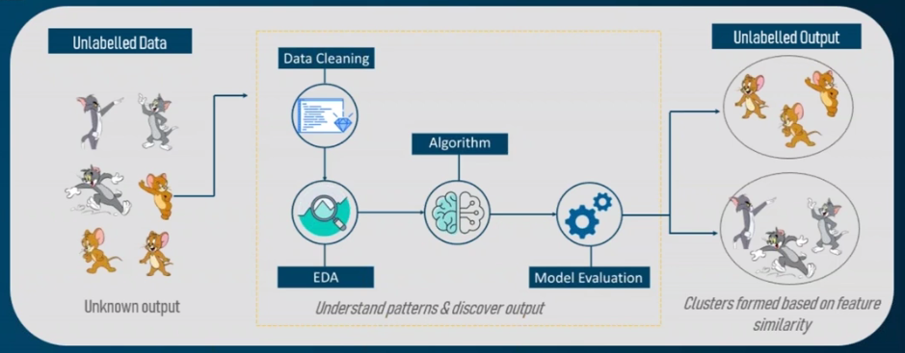
Unsupervised Learning

Slide 50
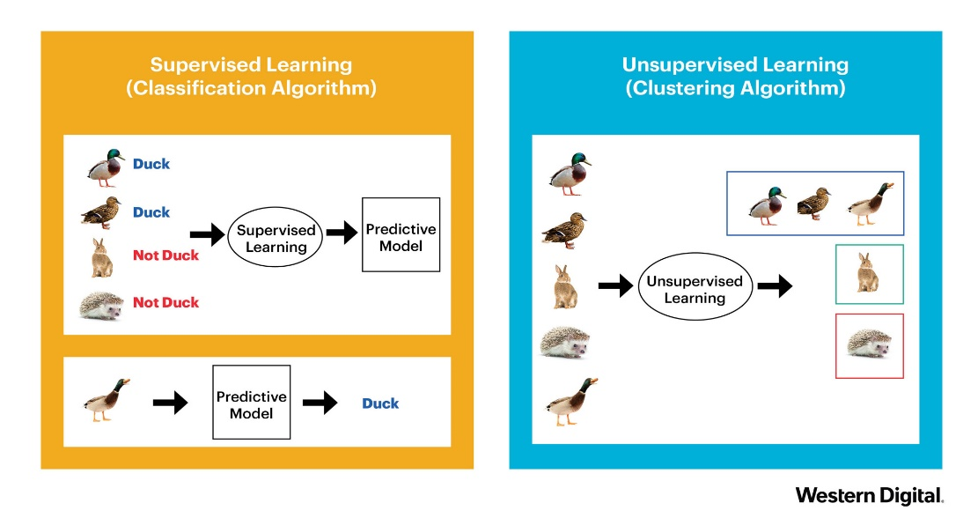

Slide 51
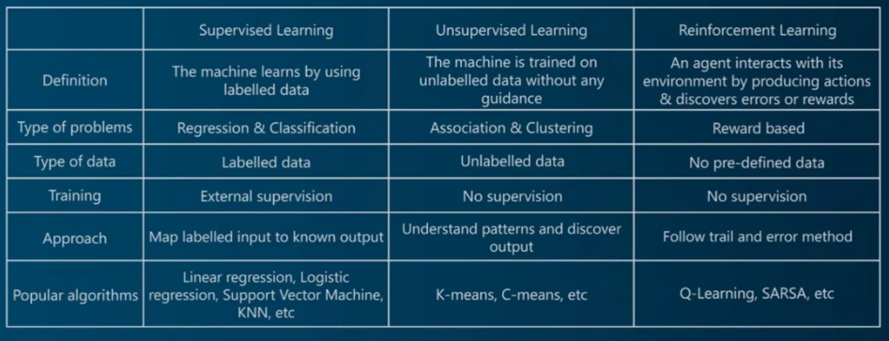

Slide 52
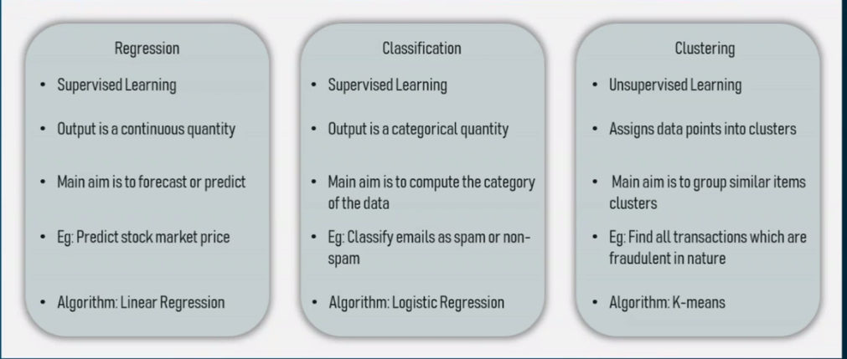

Slide 53
Supervised Learning
Regression
Linear Regression
Classification
Logistic Regression
Decision Tree Regressor
Random Forest Regressor
Decision Tree
Random Forest
KNN
Unsupervised Learning
K-Means Clustering
Hierarchial Clustering

Slide 54
Steps in building ML model
Take the Data and create a dataframe
Preprocessing – Filtering of Data ( Data Cleaning, Encoding, Dropping values, Missing values ) [ EDA ]
Data Visualization
Divide into Input and Output (x – i/p , y-o/p)
Train and Test Variables
Normalize (Scaling) the data (Inputs only)
Run a Classifier/Regressor/Clusterer(Apply suitable Algorithm)
Fit the model (Map inputs with output)
Predict the output
Evaluation : Accuracy score , Confusion Matrix

Slide 55
train_test_split
Data
x
x_train
x_test
y
y_train
y_test
Features
Inputs
Targets
Outputs
Avaialble in model_selection library of sklearn package

Slide 56
SKLEARN/SCIKIT LEARN
IT IS A PACKAGE USED FOR ML MODELS
Documentation

Slide 57
LINEAR REGRESSION
ALGORITHM

Slide 58
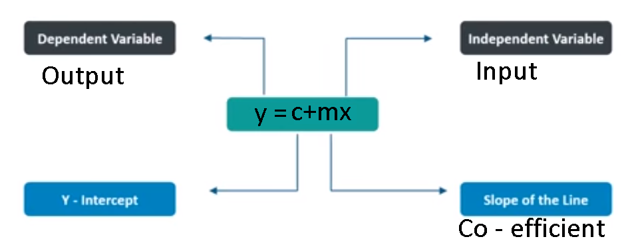
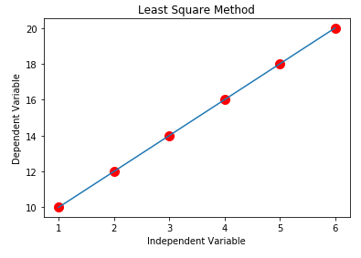
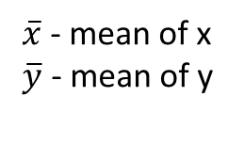
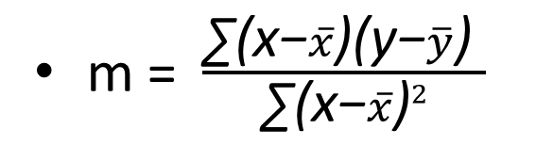
Linear Regression – From Scratch
m = $\frac{\text{∑(}\text{x}\text{−}\overline{x}\text{)(}\text{y}\text{−}\overline{y}\text{) }}{\text{∑(}\text{x}\text{−}\overline{x}\text{)}2}$
$\overline{x}$ - mean of x
$\overline{y}$ - mean of y
https://www.socscistatistics.com/tests/regression/default.aspx

Slide 59
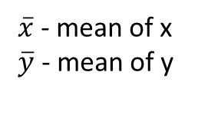
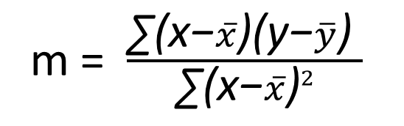
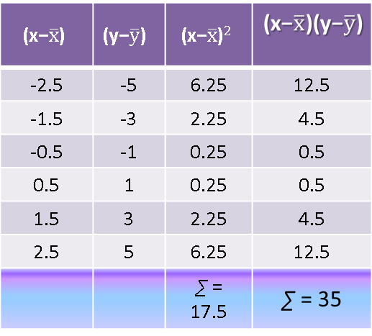
m = $\frac{\text{∑(}\text{x}\text{−}\overline{x}\text{)(}\text{y}\text{−}\overline{y}\text{) }}{\text{∑(}\text{x}\text{−}\overline{x}\text{)}2}$
x | y
1 | 10
2 | 12
3 | 14
4 | 16
5 | 18
6 | 20
Mean = 3.5 | Mean = 15.0
$$\text{(}\text{x}\text{−}\overline{x}\text{)}$$ | $$\text{(}\text{y}\text{−}\overline{y}\text{) }$$ | $$\text{(}\text{x}\text{−}\overline{x}\text{)}2$$ | $$\text{(}\text{x}\text{−}\overline{x}\text{)}\text{(}\text{y}\text{−}\overline{y}\text{)}$$
-2.5 | -5 | 6.25 | 12.5
-1.5 | -3 | 2.25 | 4.5
-0.5 | -1 | 0.25 | 0.5
0.5 | 1 | 0.25 | 0.5
1.5 | 3 | 2.25 | 4.5
2.5 | 5 | 6.25 | 12.5
 |  | $\text{∑}$ = 17.5 | $\text{∑}$ = 35
$\overline{x}$ - mean of x
$\overline{y}$ - mean of y
m = 2
y = mx+c
c= ymean-m*xmean
c =8

Slide 60
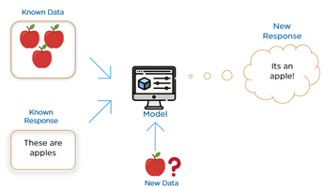
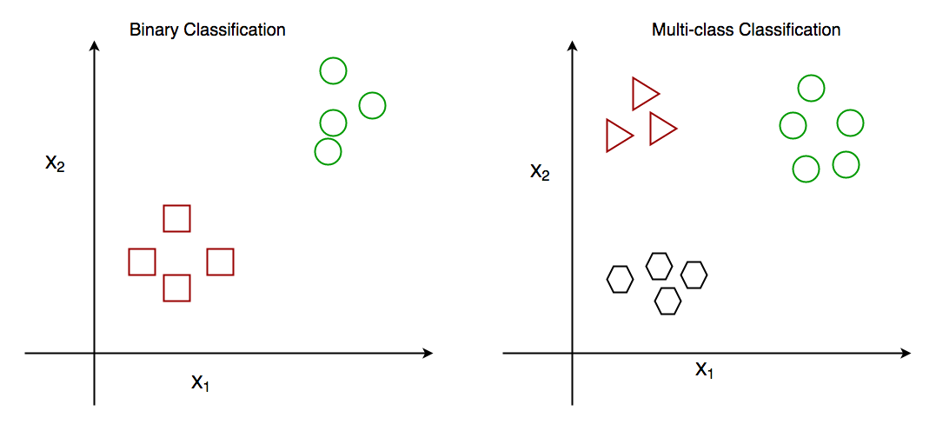
Classification

Slide 61
LOGISTIC REGRESSION

Slide 62
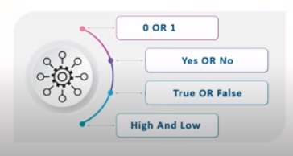
Logistic Regression
In statistics, the logistic model is used to
model the probability of a certain class or
event existing such as pass/fail, win/lose,
alive/dead or healthy/sick.

Slide 63
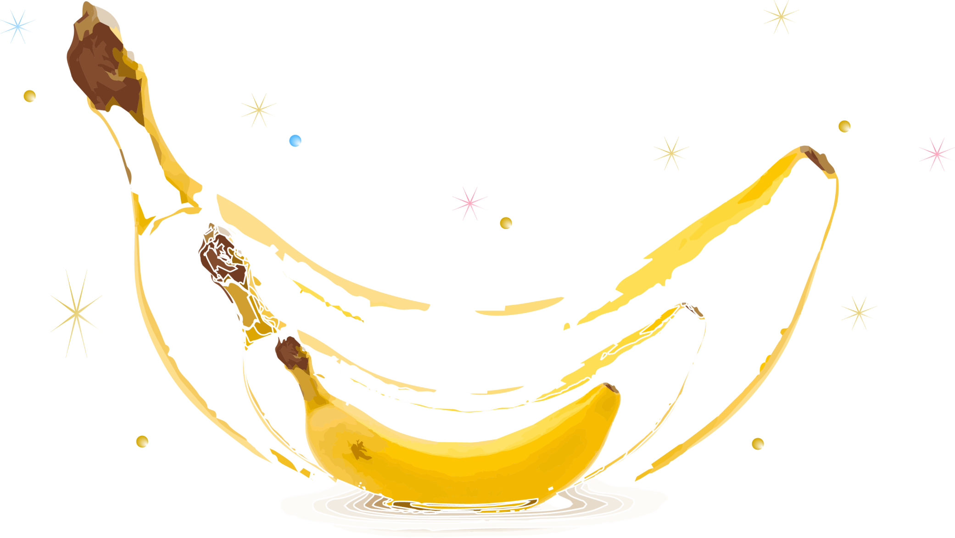
Normalization/Scaling
The goal of normalization is to change the values
of numeric columns in the dataset to a common scale,
without distorting differences in the ranges of values

Slide 64
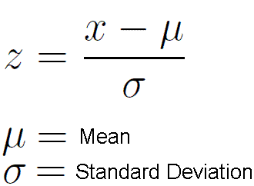
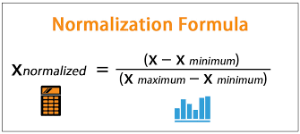
Types
1. Min Max Scaler – (0,1)
2. Standard Scaler (0 as median )
Standard Scaler
Min Max Scaler

Slide 65
How to use Min Max Scaler?
For X training set, we do "fit_transform" because we need to compute features, and then use it to autoscale the data. For X test set, well, we already have the features, so we only do the "transform" part.
https://stackoverflow.com/questions/48692500/fit-transform-on-training-data-and-transform-on-test-data
https://www.analyticsvidhya.com/blog/2020/04/feature-scaling-machine-learning-normalization-standardization/

Slide 66
K NEAREST NEIGHBORS
Classifier

Slide 67
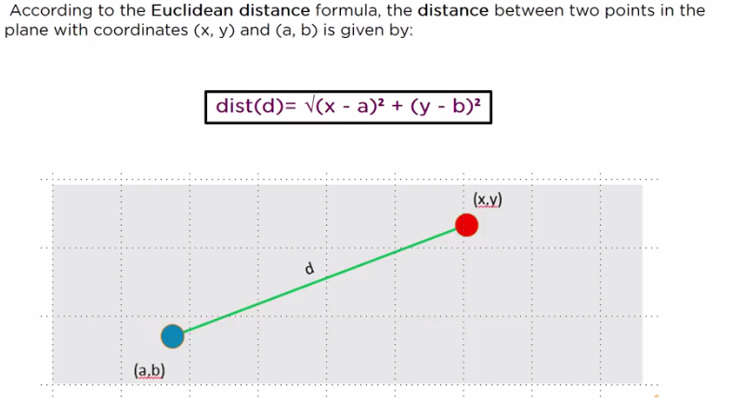
KNN

Slide 68
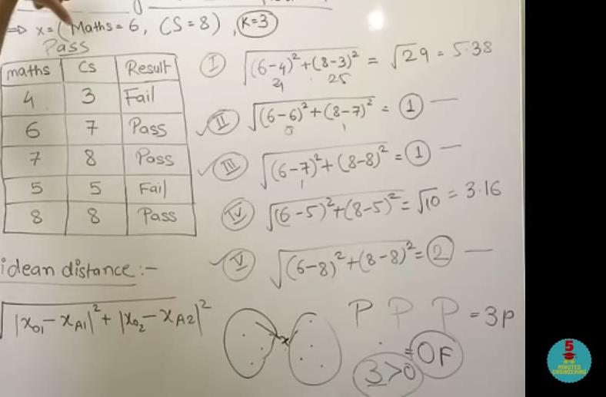
KNN

Slide 69
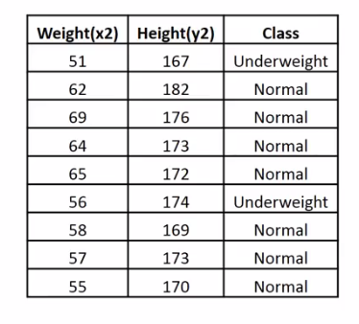
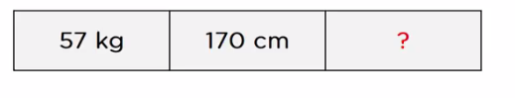

Slide 70
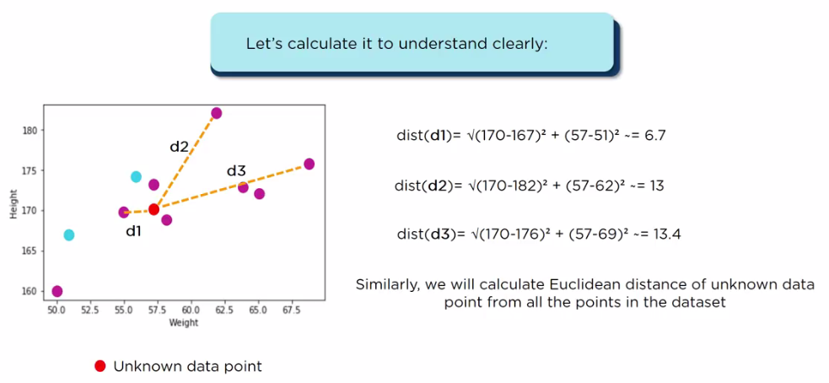

Slide 71
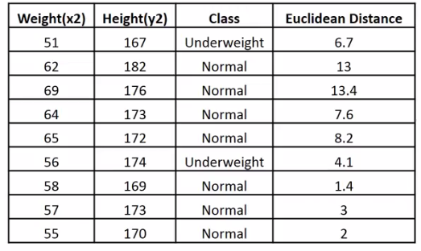

Slide 72
Thanks!
Any questions?

